Slide 1
Your PRIVATE IOT GYM
Is it possible?
Of Course!
Notes:
© Copyright Showeet.com – Free PowerPoint Templates

Slide 2
We need more sports!
That is a fact that we cannot deny!
Notes:
© Copyright Showeet.com – Free PowerPoint Templates

Slide 3
Did you know?
Worldwide obesity has nearly tripled since 1975.
In 2016, more than 1.9 billion adults, were overweight. Of these over 650 million were obese.
One in 12 deaths can be prevented with 30 minutes of physical activity 5 days a week
Notes:
© Copyright Showeet.com – Free PowerPoint Templates

Slide 4

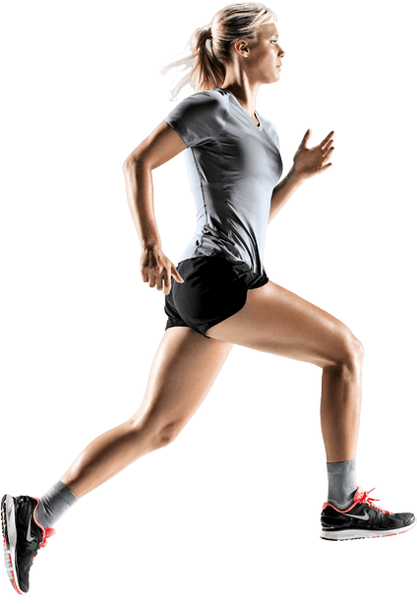

What can we do?
Idea?
Notes:
© Copyright Showeet.com – Free PowerPoint Templates

Slide 5
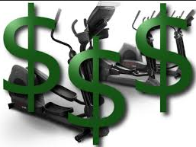
But it is expensive and takes time
Notes:
© Copyright Showeet.com – Free PowerPoint Templates

Slide 6

Build your own IoT home gym with only one dumbbell!
It connects with others, inspires, and motivates people!
Notes:
© Copyright Showeet.com – Free PowerPoint Templates

Slide 7



Prototype
Raspberry Pi with any dumbbell or any weight
Notes:
© Copyright Showeet.com – Free PowerPoint Templates

Slide 8
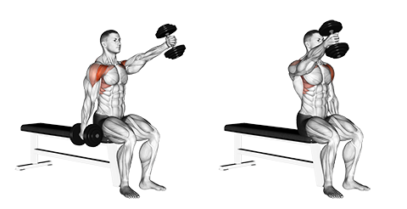
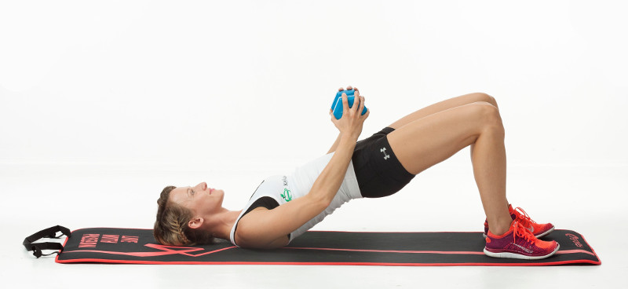
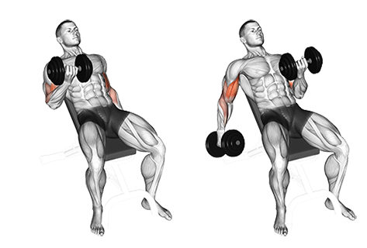
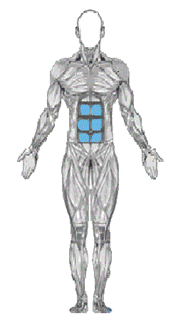
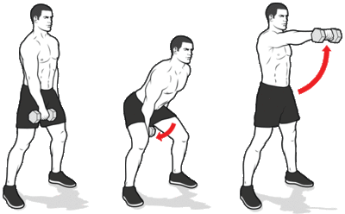
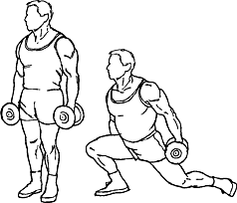
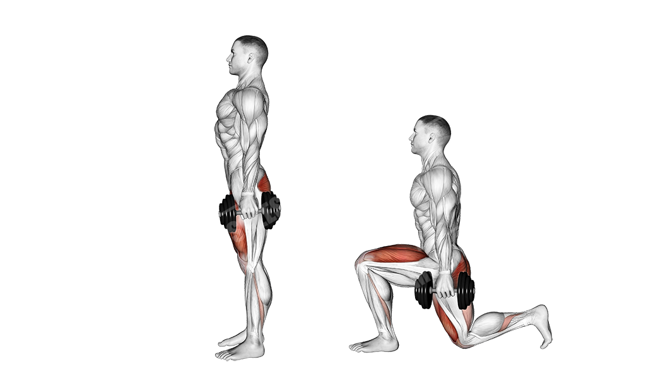
Do you know that you don’t need all gym devices to train all your muscles?
Raspberry Pi with any dumbbell
Notes:
© Copyright Showeet.com – Free PowerPoint Templates

Slide 9
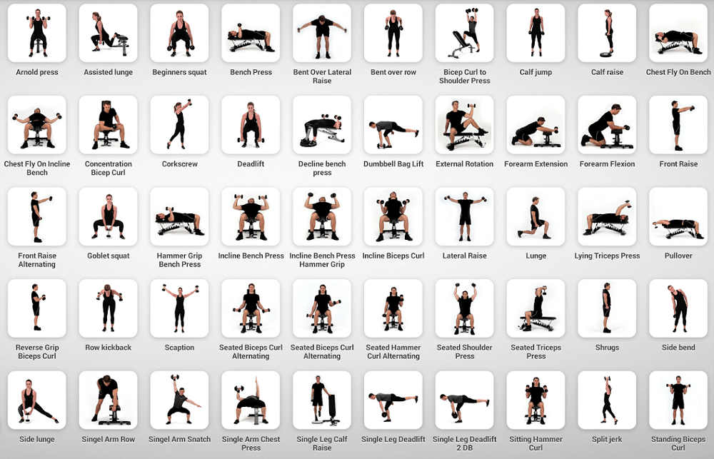

Slide 10

Easy to connect to any gym device
Notes:
© Copyright Showeet.com – Free PowerPoint Templates

Slide 11
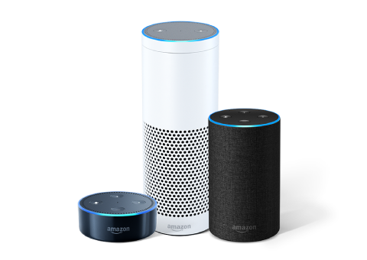
Integrated with Alexa trainer skill
Notes:
© Copyright Showeet.com – Free PowerPoint Templates

Slide 12
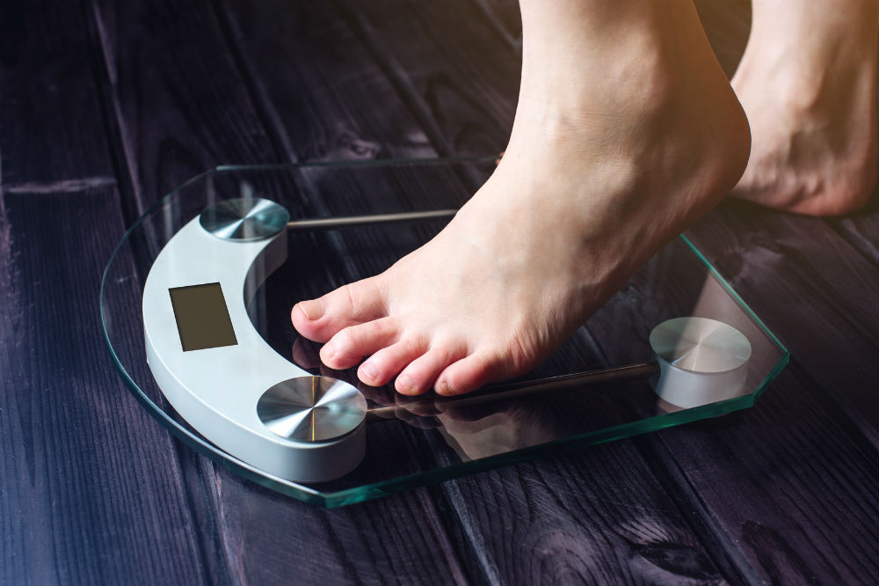
Integrated with smart Arduino Scale
Notes:
© Copyright Showeet.com – Free PowerPoint Templates

Slide 13
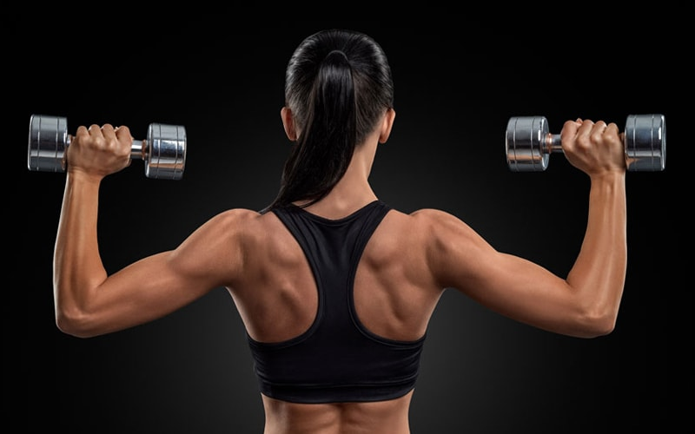
Voice counter of your exercises
Notes:
© Copyright Showeet.com – Free PowerPoint Templates

Slide 14




Try to give your your friend challenge
Hey Alice, Bob wants to give you a challenge. Every day 20 pushups till 10 am! Are you in?
Alexa, start myGym and tell Bob I accepted his chalanged
Cross motivation
Notes:
© Copyright Showeet.com – Free PowerPoint Templates

Slide 15
Play your favourite music with Alexa
Notes:
© Copyright Showeet.com – Free PowerPoint Templates

Slide 16
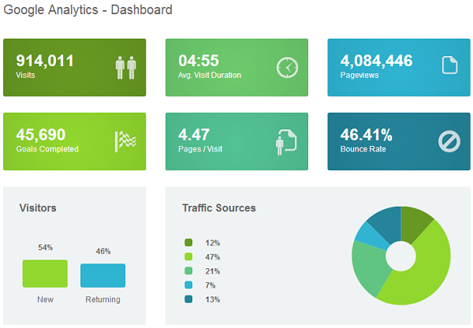
Online Dashboard with your results
AI will build your plan which are based on results of other similar users!
Notes:
© Copyright Showeet.com – Free PowerPoint Templates

Slide 17
SHOW PRIVATE CASE GYM
Is it possible?
Of Course!
Notes:
© Copyright Showeet.com – Free PowerPoint Templates

Slide 18
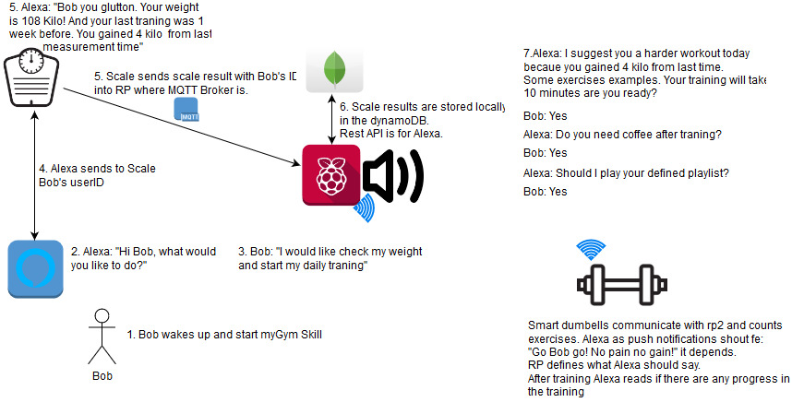
Notes:
© Copyright Showeet.com – Free PowerPoint Templates

Slide 19
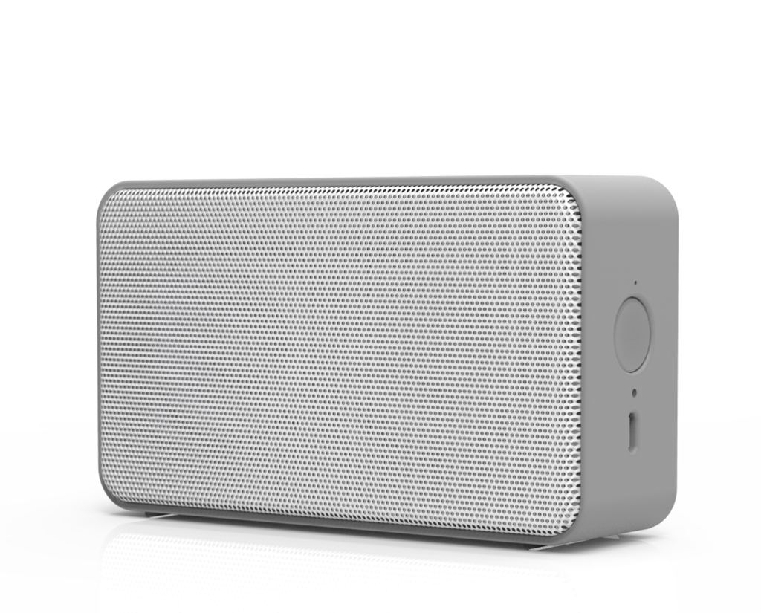
Wake up with your trainer
Get motivational messages from the Bluetooth speaker. Every repeat of an exercises funny messages:
“No pain no gain!”
“Never give in. Never give in. Never, never, never, never—in nothing, great or small, large or petty—never give in”
Notes:
© Copyright Showeet.com – Free PowerPoint Templates

Slide 20

Alexa your fitness trainer will tell you what exercise to do
You can ask her to read you books during a training or play music!
Notes:
© Copyright Showeet.com – Free PowerPoint Templates

Slide 21
Thank You !
Notes:
© Copyright Showeet.com – Free PowerPoint Templates

